Slide 1
Latent Variable PCFGs
Extending the idea to induced syntactico-semantic classes

Slide 2
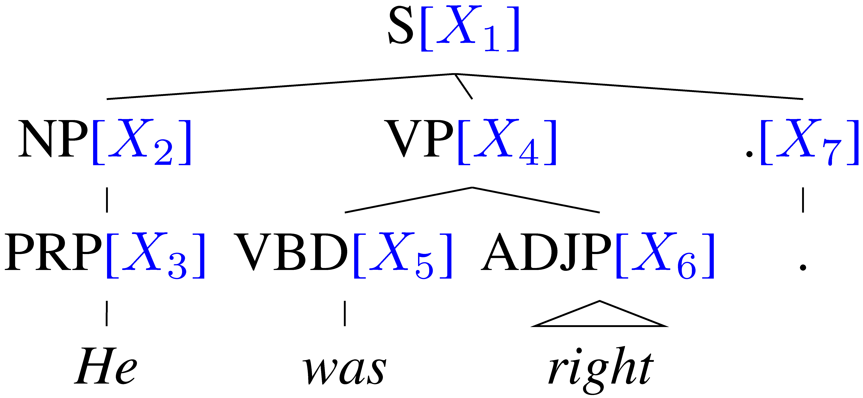
Learning Latent Annotations [Petrov and Klein 2006, 2007]
Outside
Can you automatically find good symbols?
Brackets are known
Base categories are known
Induce subcategories
Clever split/merge category refinement
X₁
X₂
X₄
X₇
X₃
X₅
X₆
.
He
was
right
EM algorithm, like Forward-Backward for HMMs, but constrained by tree
Inside
Notes:
How are we going to this? We will use an EM algorithm as Matsuzaki et al. did. The details are in their paper and also in ours and I will just give a quick high level overview. Since the brackets and categories for our training trees are already known, we only need to induce the subcategories. This means that we do not need to run the general inside outside algorithm. We can turn our parse trees into tree shaped graphical models and then use an algorithm just like the forward backward algorithm for HMMs. To emphasize, we don’t need to run the inside outside algorithm and the algorithm is not cubic but linear, therefore training can be done efficiently.

Slide 3
POS tag splits’ commonest words: effectively a semantic class-based model
Proper Nouns (NNP):
Personal pronouns (PRP):
NNP-14 | Oct. | Nov. | Sept.
NNP-12 | John | Robert | James
NNP-2 | J. | E. | L.
NNP-1 | Bush | Noriega | Peters
NNP-15 | New | San | Wall
NNP-3 | York | Francisco | Street
PRP-0 | It | He | I
PRP-1 | it | he | they
PRP-2 | it | them | him
Notes:
Before I finish, let me give you some interesting examples of what our grammars learn. These are intended to highlight some interesting observations, the full list of subcategories and more details are in the paper.
The subcategories sometimes capture syntactic and sometimes semantic difference. But very often they represent syntactico – semantic relations, which are similar to those found in distributional clustering results.
For example for the proper nouns the system learns a subcategory for months, first names, last names and initials. It also learns which words typically come first and second in multi-word units.
For personal pronouns there is a subcategory for accusative case and one for sentence initial and sentence medial nominative case.

Slide 4
Number of phrasal subcategories
Notes:
Here are the number of subcategories for each of the 25 phrasal categories. In general phrasal categories are split less heavily than lexical categories, a trend that one could have expected.

Slide 5
The Latest Parsing Results… (English PTB3 WSJ train 2-21, test 23)
 | F1 ≤ 40 words | F1 all words
Parser
Klein & Manning unlexicalized 2003 | 86.3 | 85.7
Matsuzaki et al. simple EM latent states 2005 | 86.7 | 86.1
Charniak generative, lexicalized (“maxent inspired”) 2000 | 90.1 | 89.5
Petrov and Klein NAACL 2007 | 90.6 | 90.1
Charniak & Johnson discriminative reranker 2005 | 92.0 | 91.4
Fossum & Knight 2009 combining constituent parsers |  | 92.4
Notes:
Not only that, we even outperform the fully lexicalized systems of Collins ’99 and the generative component of Charniak and Johnson ’05.

Slide 6
Latent Variable PCFGs
Extending the idea to induced syntactico-semantic classes

